Slide 1
Unit 19: Polynomial Regression

Slide 2
Learning Objectives
What is polynomial regression and when is it appropriate
Contrast with other non-linear methods
Interpret coefficients from quadratic models when X is centered and uncentered
Test and describe overall effect of predictor variable X
Test and describe linear and quadratic effects of X
Test simple effects of X
Use “calculus” to describe how effect of X changes over range of X
Understand conceptual link between polynomial regression and interactions
Use calculus to describe interaction effect
Analyze polynomial effect of X with additive covariate
Write up results and make figure

Slide 3
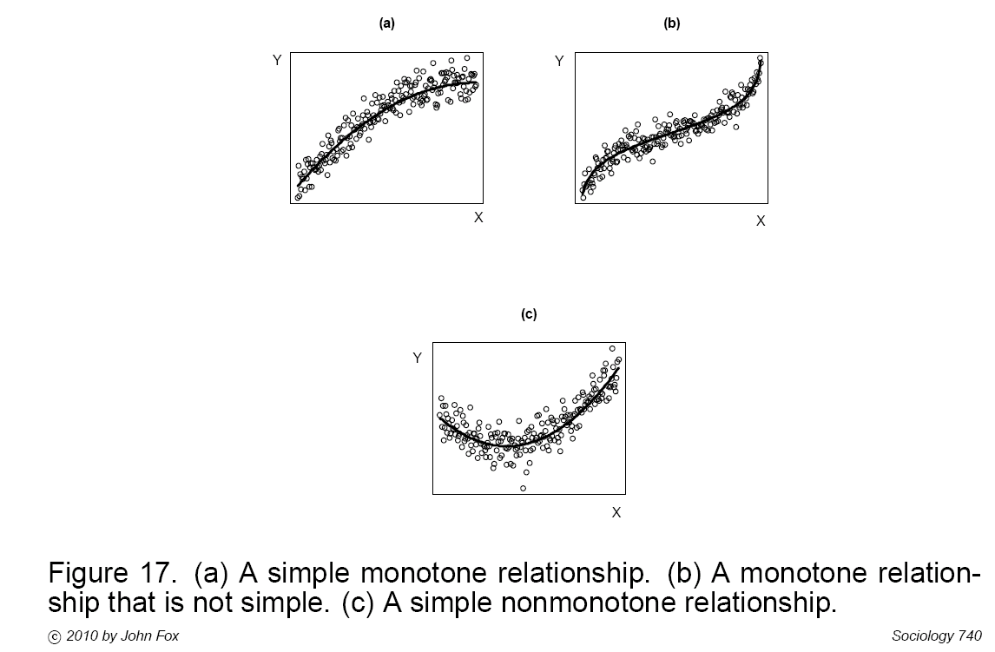
How to Handle Non-Linear Effects
Power transformations can make simple monotone relationships more linear (Fig A). Polynomial regression (or other transformations, e.g. logit) is often needed for more complex relationships (Figs, B & C)

Slide 4
How to Handle Non-Linear Effects
Simple monotonic relationships: Power transformations.
Polynomial Regression- Quantitative Variables
[Polynomial Regression- Categorical Variables]
Generalized Linear Models (e.g., logistic regression)

Slide 5
Non-Linear Effects in MR/GLM
Multiple regression/GLM is “linear in the regressors”
The predicted score is a linear combination of the regressors (X’s) in the model
Each regressor is multiplied by its coefficient and added together (+ intercept/constant)
Y’ = b₁X₁ + b₂X₂ + …… b₀

Slide 6
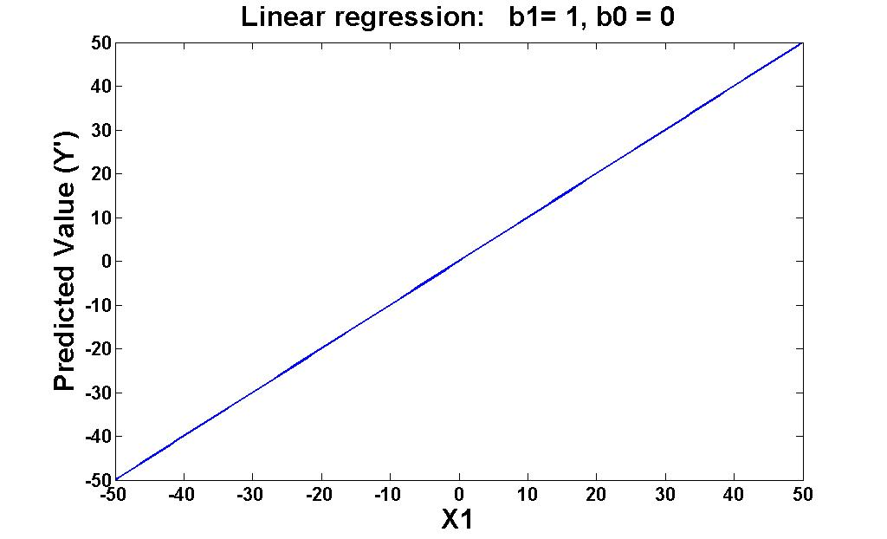
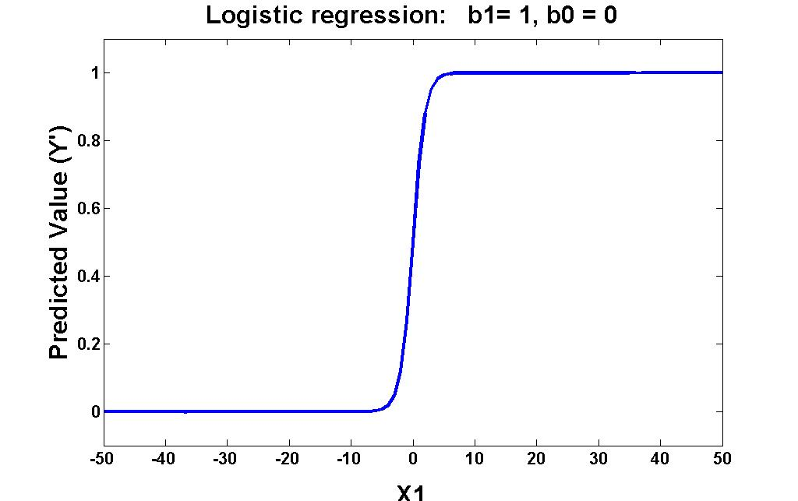
Linear vs. Logistic Regression
Multiple Regression Logistic Regression
Y′ = b₀ + b₁X₁ Y′ = e ^{b0 + b1X1}
(1+ e^{b0 + b1X1})
Predicted values graphed for X1 = -50 to 50

Slide 7
Polynomial Regression
Y′ = A + BX + CX² + DX³ + ….. QX^{N-1}
It is important to distinguish between regressors in the model vs. variables of interest.
In this example there is only one variable of interest. The powers of X act as a structural set of regressors to allow for non-linear relationships between this variable of interest & Y.
However, the model is still linear in the regressors. I.E. linear combination of the regressors multiplied by their parameter estimates.

Slide 8
Polynomial Regression Order
Y′ = A + BX + CX² + DX³ + ….. QX^{N-1}
If you include (N-1) regressors based on X, you will perfectly fit the data.
The order of the equation is the highest power: (N-1) in this example.
X^{(N-1)} is the highest order predictor. All other regressors are lower order.
The highest order regressor determines the overall shape of the relationship within the range of –inf to inf

Slide 9
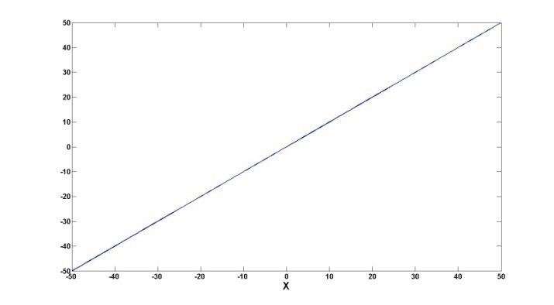
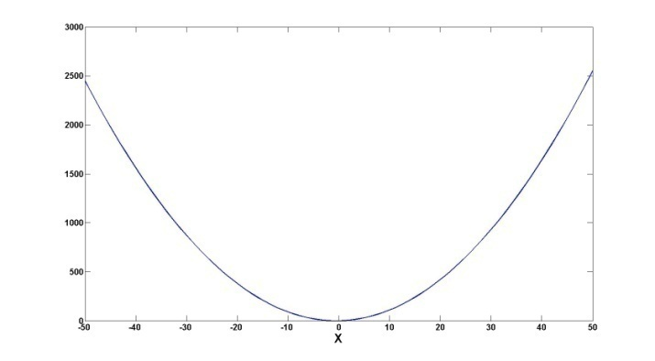
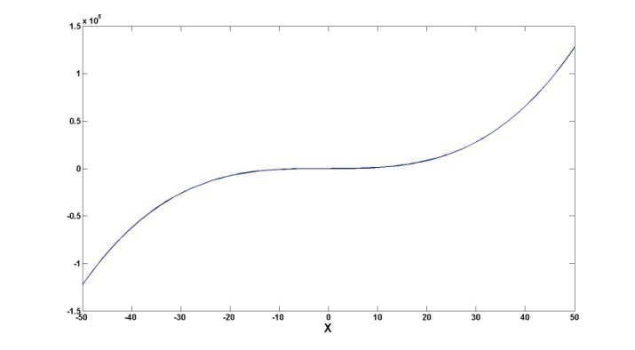
Polynomial Regression Shape
Y′ = A + BX + CX² + DX³ + ….. QX^{N-1}
The highest order regressor determines the overall shape of the relationship within the range of –inf to inf
Linear Quadratic Cubic
Y′ = A + BX Y′ = A+ BX + CX² Y′ = A+ BX + CX² + DX³
Zero bends One bend Two bends
There is one less bend than the highest order in the polynomial model

Slide 10
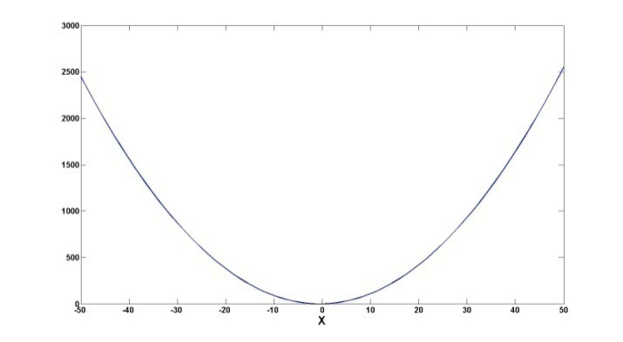
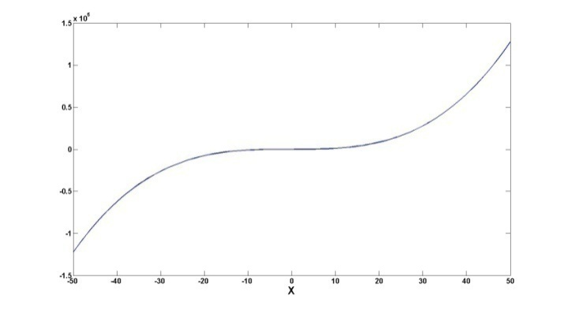
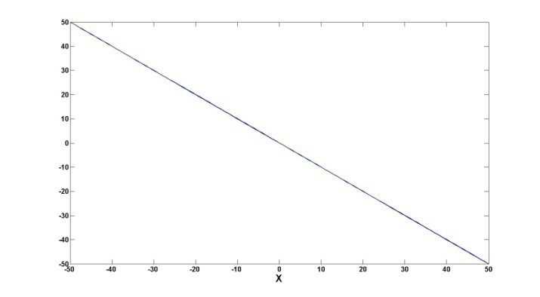
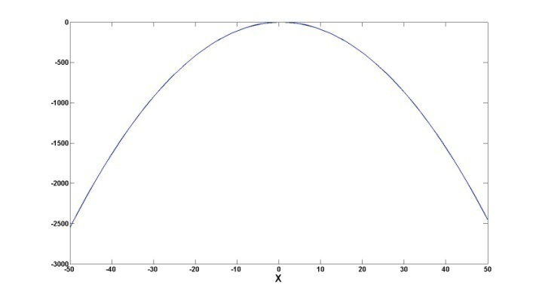
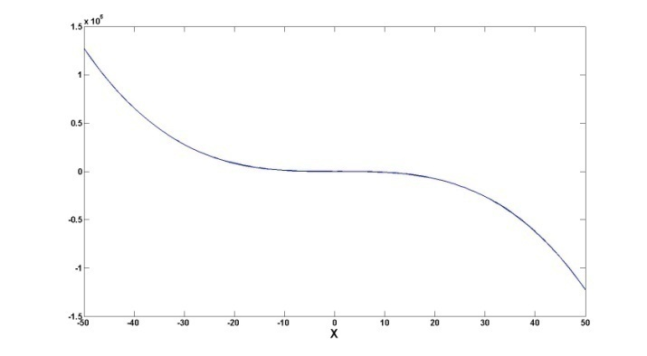
Shape and Coefficient Sign
The sign of the coefficient for the highest order regressor determines the direction of the curvature
Linear Quadratic Cubic
Y’ = 0 + 1X Y’ = 0 + 1X + 1X² Y’ = 0 + 1X + 1X² + 1X³
Y’ = 0 + -1X Y’ = 0 + 1X + -1X² Y’ = 0 + 1X + 1X² + -1X³

Slide 11
How to Determine Order
Can fit order up to N-1 but wont
Theory should generally guide order
Social science theory rarely predicts higher than cubic (and typically not higher than quadratic)
Sometimes higher order models (quadratic, cubic) are implicated by the distribution of residuals.

Slide 12
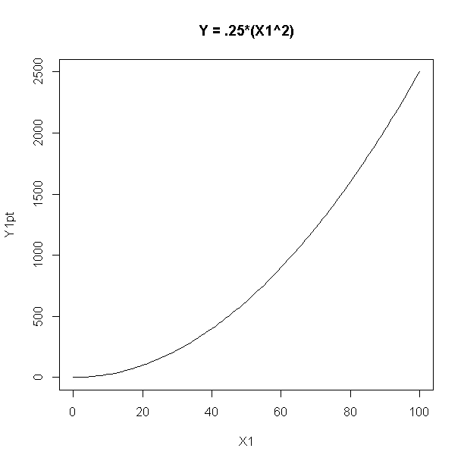
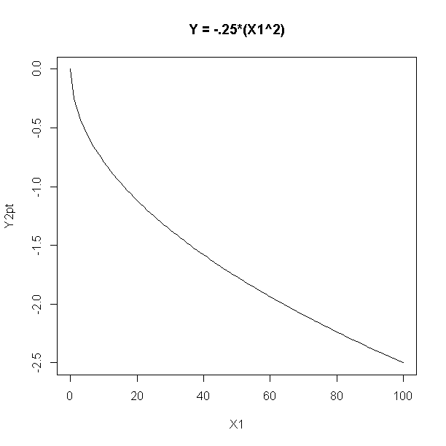
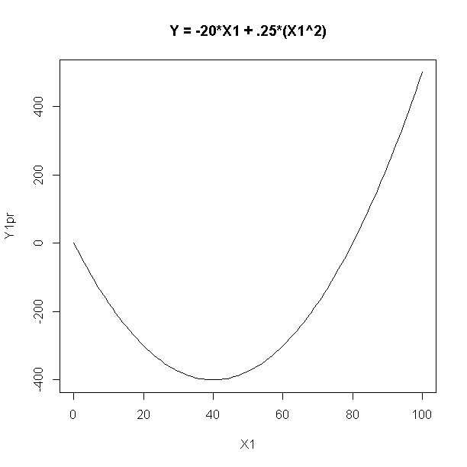
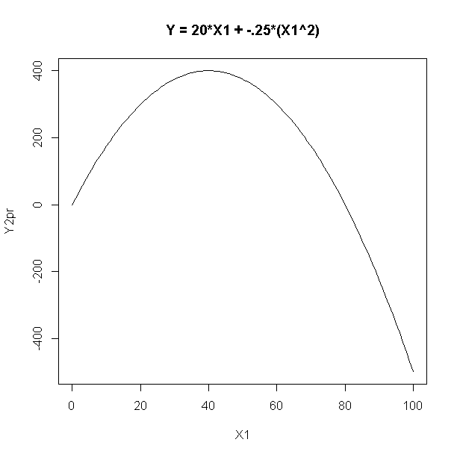
Polynomial vs. Power Transformation of X
Power Transformations of X
Polynomial Regression

Slide 13
Example 1: Predicting Interest in Electives
How does number of electives taken in an area predict interest in further electives?
varDescribe(dE)
var n mean sd median trimmed mad min max range skew
Electives 1 100 8.17 3.09 8.00 8.15 2.97 1.00 17.00 16.00 0.14
Interest 2 100 18.10 4.75 19.33 18.58 3.62 3.56 26.49 22.92 -0.96
kurtosis se
Electives -0.30 0.31
Interest 0.74 0.47
cor(dE)
Electives Interest
Electives 1.0000000 0.7488801
Interest 0.7488801 1.0000000

Slide 14
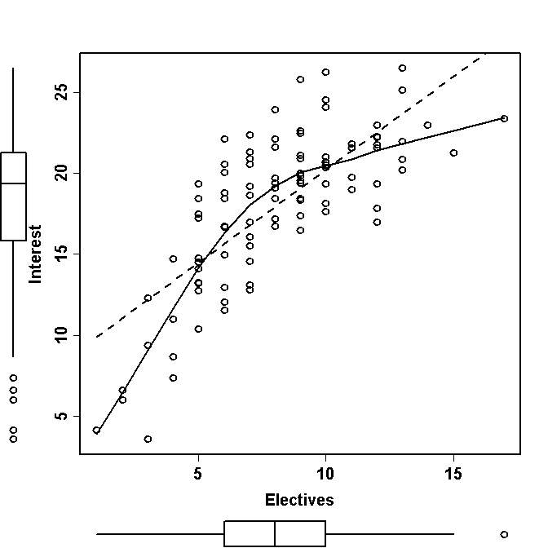
Example 1: Predicting Interest in Electives
scatterplot(dE$Electives, dE$Interest,cex=1.5, lwd=2,xlab = 'Electives',
ylab='Interest', col='black')

Slide 15
Example 1: Predicting Interest in Electives
mLinear = lm(Interest ~ Electives, data=dE)
summary(mLinear)
Coefficients
Estimate SE t-statistic Pr(>|t|)
(Intercept) 8.7177 0.8968 9.721 4.87e-16 ***
Electives 1.1490 0.1027 11.187 < 2e-16 ***
---
Signif. codes: 0 ‘***’ 0.001 ‘**’ 0.01 ‘*’ 0.05 ‘.’ 0.1 ‘ ’ 1
Sum of squared errors (SSE): 980.2, Error df: 98
R-squared: 0.5608

Slide 16
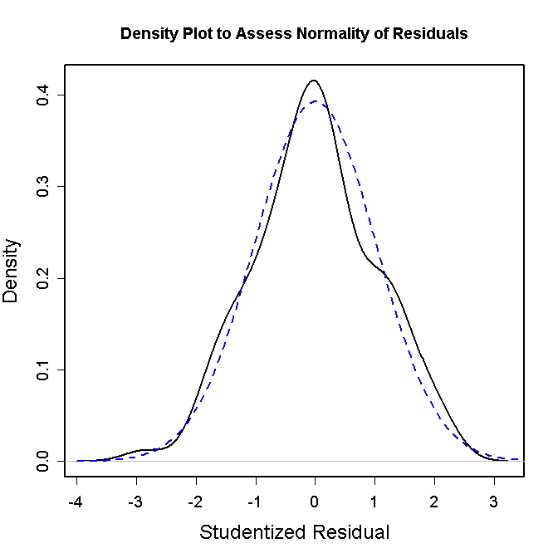
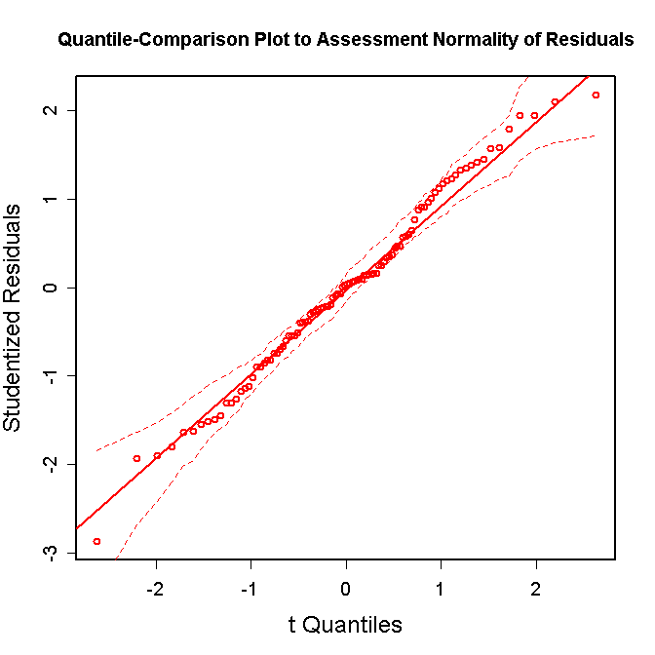
Example 1: Predicting Interest in Electives
modelAssumptions(mLinear,Type=‘normal')

Slide 17
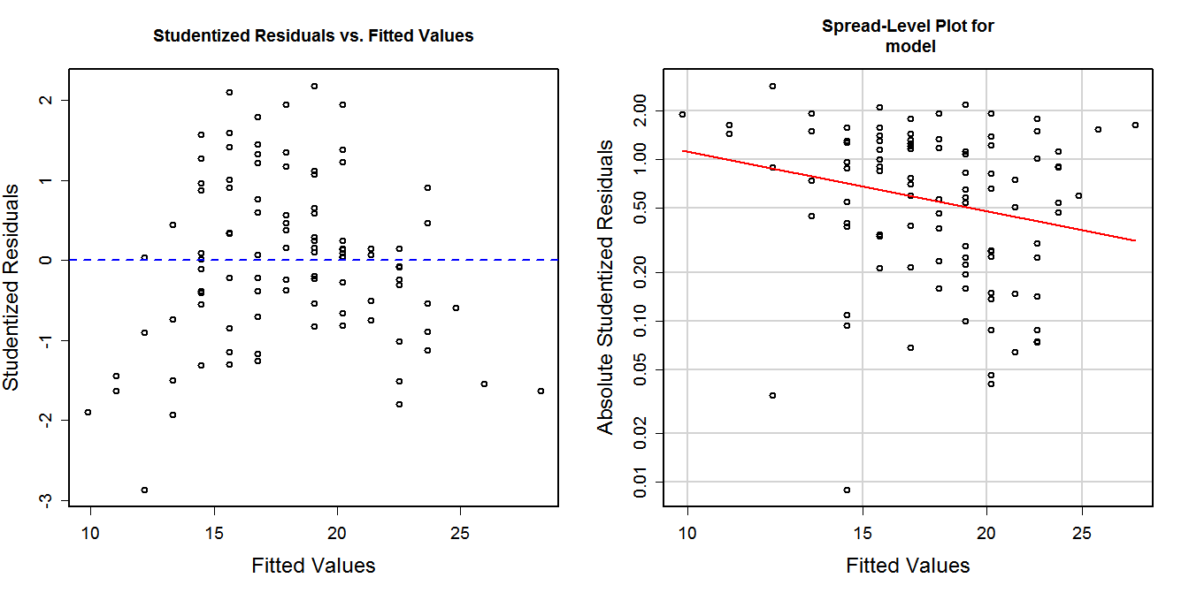
Example 1: Predicting Interest in Electives
modelAssumptions(mLinear,Type='constant', one.page=FALSE)

Slide 18
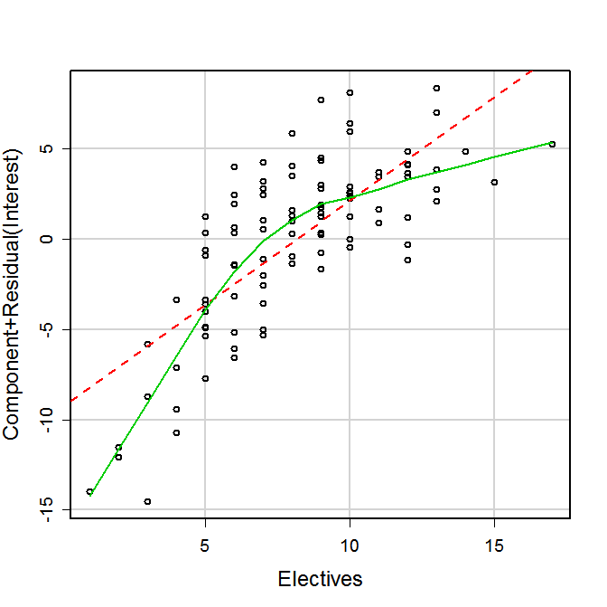
Example 1: Predicting Interest in Electives
modelAssumptions(mLinear,Type=‘linear', one.page=FALSE)

Slide 19
Example 1: Predicting Interest in Electives
ASSESSMENT OF THE LINEAR MODEL ASSUMPTIONS
USING THE GLOBAL TEST ON 4 DEGREES-OF-FREEDOM:
Level of Significance = 0.05
Call:
gvlma(x = model)
Value p-value Decision
Global Stat 26.970200 2.016e-05 Assumptions NOT satisfied!
Skewness 0.005409 9.414e-01 Assumptions acceptable.
Kurtosis 0.475458 4.905e-01 Assumptions acceptable.
Link Function 25.445431 4.551e-07 Assumptions NOT satisfied!
Heteroscedasticity 1.043902 3.069e-01 Assumptions acceptable.

Slide 20
Example 1: Predicting Interest in Electives
mLinear = lm(Interest ~ Electives, data=dE)
summary(mLinear)
Coefficients:
Estimate Std. Error t value Pr(>|t|)
(Intercept) 8.7177 0.8968 9.721 4.87e-16
Electives 1.1490 0.1027 11.187 < 2e-16
Residual standard error: 3.163 on 98 degrees of freedom
Multiple R-squared: 0.5608, Adjusted R-squared: 0.5563
F-statistic: 125.1 on 1 and 98 DF, p-value: < 2.2e-16
What are your concerns about interpreting this model?
The linearity assumption regarding the electives effect is pretty clearly violated. When this assumption is violated, the parameter estimates are biased. In this case, you can expect that the model is underestimating the true magnitude of the electives effect. This is a bad model!

Slide 21
How to estimate polynomial (quadratic) model
dE$Electives2 = dE$Electives * dE$Electives
mQuad= lm(Interest ~ Electives + Electives2, data=dE)
summary(mQuad)
Coefficients
Estimate SE t-statistic Pr(>|t|)
(Intercept) 1.0031 1.5503 0.647 0.519
Electives 3.2743 0.3800 8.617 0.000000000000129 ***
Electives2 -0.1266 0.0220 -5.754 0.000000101764858 ***
---
Sum of squared errors (SSE): 730.8, Error df: 97
R-squared: 0.6726
mQuad= lm(Interest ~ Electives + I(Electives^2), data=dE)
summary(mQuad)
Coefficients
Estimate SE t-statistic Pr(>|t|)
(Intercept) 1.0031 1.5503 0.647 0.519
Electives 3.2743 0.3800 8.617 0.000000000000129 ***
I(Electives^2) -0.1266 0.0220 -5.754 0.000000101764858 ***
---
Sum of squared errors (SSE): 730.8, Error df: 97
R-squared: 0.6726

Slide 22
Compare linear and quadratic models
mQuad = lm(Interest ~ Electives + I(Electives^2), data=dE)
summary(mQuad)
Coefficients
Estimate SE t-statistic Pr(>|t|)
(Intercept) 1.0031 1.5503 0.647 0.519
Electives 3.2743 0.3800 8.617 0.000000000000129 ***
I(Electives^2) -0.1266 0.0220 -5.754 0.000000101764858 ***
---
Sum of squared errors (SSE): 730.8, Error df: 97
R-squared: 0.6726
mLinear = lm(Interest ~ Electives, data=dE)
summary(mLinear)
Coefficients
Estimate SE t-statistic Pr(>|t|)
(Intercept) 8.7177 0.8968 9.721 4.87e-16 ***
Electives 1.1490 0.1027 11.187 < 2e-16 ***
---
Sum of squared errors (SSE): 980.2, Error df: 98
R-squared: 0.5608

Slide 23
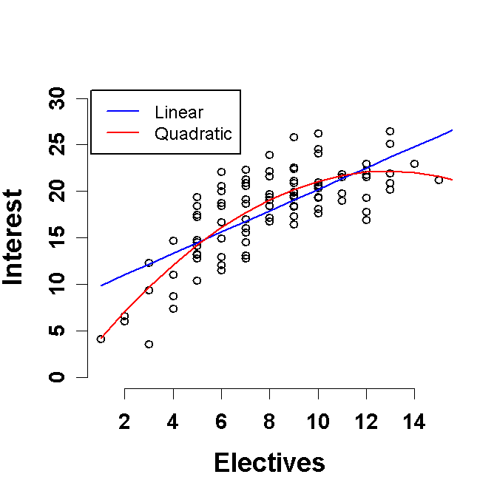
Example 1: Predicting Interest in Electives
Linear model
Interest = 8.7 + 1.4*Electives
Quadratic model
Interest = 1.0 + 3.3*Electives + -0.1*Electives²

Slide 24
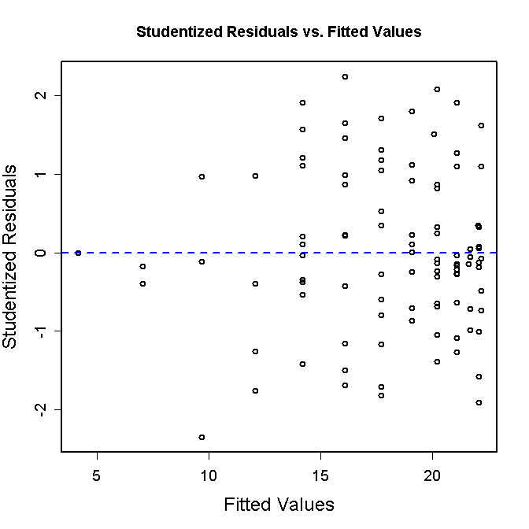
Example 1: Predicting Interest in Electives

Slide 25
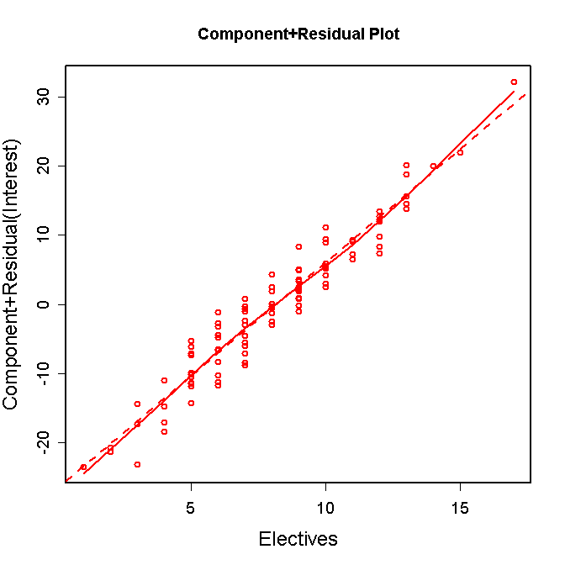
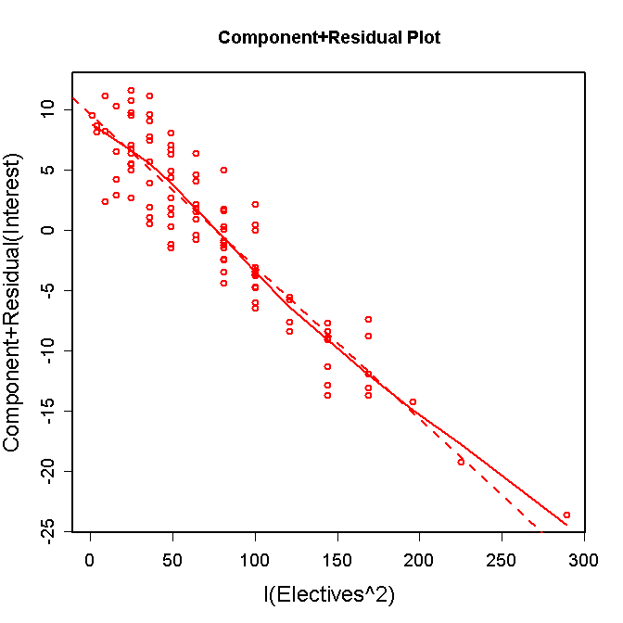
Example 1: Predicting Interest in Electives

Slide 26
How to test overall effect of variable
mQuad = lm(Interest ~ Electives + I(Electives^2), data=dE)
summary(mQuad)
Coefficients
Estimate SE t-statistic Pr(>|t|)
(Intercept) 1.0031 1.5503 0.647 0.519
Electives 3.2743 0.3800 8.617 0.000000000000129 ***
I(Electives^2) -0.1266 0.0220 -5.754 0.000000101764858 ***
---
Sum of squared errors (SSE): 730.8, Error df: 97
R-squared: 0.6726
How do we get a test of the overall Electives effect in polynomial (i.e., quadratic) model?
The test of the set of regressors that code for Electives, In this case, Electives and Electives² provides the overall test. Can use R² here b/c these are the only two regressors in the model. What if there were other control variables in model?

Slide 27
Is quadratic model better
mQuad = lm(Interest ~ Electives + I(Electives^2), data=dE)
summary(mQuad)
Coefficients:
Estimate Std. Error t value Pr(>|t|)
(Intercept) 1.0031 1.5503 0.647 0.519
Electives 3.2743 0.3800 8.617 1.29e-13
I(Electives^2) -0.1266 0.0220 -5.754 1.02e-07
Residual standard error: 2.745 on 97 degrees of freedom
Multiple R-squared: 0.6726, Adjusted R-squared: 0.6658
F-statistic: 99.62 on 2 and 97 DF, p-value: < 2.2e-16
How can you test if the quadratic model is necessary?
Test if the quadratic model fits better than the linear model.
You can compare the augmented model with electives and electives² to the compact model with only electives. This is of course, equivalent to testing if the coefficient for electives² is 0.

Slide 28
Is higher order model necessary
How can you test if more complex model (e.g., cubic) is needed?
Fit the cubic and compare this augmented cubic model to quadratic model or test if the coefficient for cubic term is 0.
mCubic = lm(Interest ~ Electives + I(Electives^2) + I(Electives^3),
data=dE)
summary(mCubic)
Coefficients
Estimate SE t-statistic Pr(>|t|)
(Intercept) -2.581884 2.485665 -1.039 0.30155
Electives 4.937010 0.982495 5.025 0.00000233 ***
I(Electives^2) -0.342747 0.120023 -2.856 0.00526 **
I(Electives^3) 0.008285 0.004524 1.831 0.07015 .
---
Sum of squared errors (SSE): 706.1, Error df: 96
R-squared: 0.6836

Slide 29
Example 1: Interpreting the Coefficients
Linear model
Interest = 8.7 + 1.4*Electives
Quadratic model
Interest = 1.0 + 3.3*Electives + -0.1*Electives²
In polynomial model
b₀ interpretation is unchanged
but its value will likely change.
Predicted value when
Electives = 0
b₁ is the linear effect of
Electives at Electives = 0

Slide 30
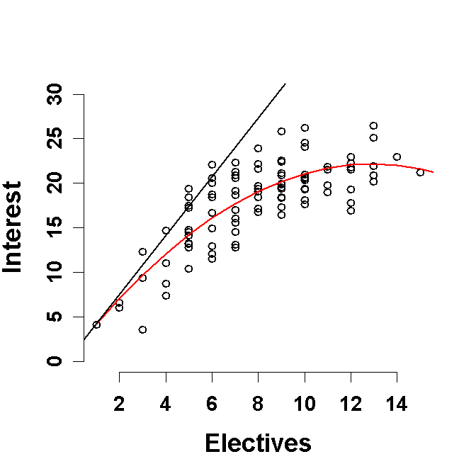
Example 1: Predicting Interest in Electives
Quadratic model
Interest = 1.0 + 3.3*Electives + -0.1*Electives²
In other words, 3.3 is the slope of the tangent line at Electives = 0
In polynomial regression,
the focus remains on
the linear effect but it
quantifies change in Y
for change in X at a point in
the X distribution
Higher order terms inform
us how the linear effect
changes across distribution
of X

Slide 31
Centering Predictors
How will model change if Electives is centered?
dE$cElectives = scale(dE$Electives,scale=FALSE)
mcQuad = lm(Interest ~ cElectives + I(cElectives^2), data=dE)
modelSummary(mcQuad)
Coefficients
Estimate SE t-statistic Pr(>|t|)
(Intercept) 19.30498 0.34473 56.000 < 2e-16 ***
cElectives 1.20599 0.08969 13.446 < 2e-16 ***
I(cElectives^2) -0.12658 0.02200 -5.754 0.000000102 ***
---
Sum of squared errors (SSE): 730.8, Error df: 97
R-squared: 0.6726
Overall model fit (i.e., overall effect of electives) will remain the same but coefficients will change.
b for cElectives will be linear effect at mean of Electives

Slide 32
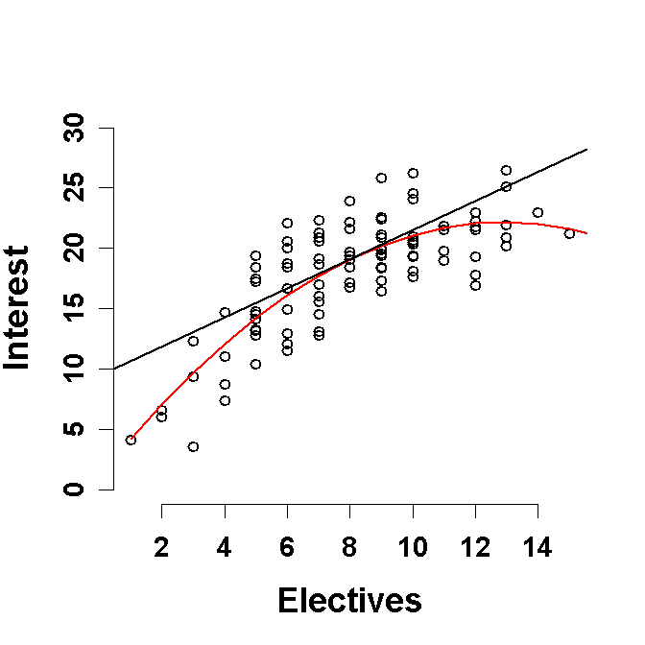
Centering Predictors
Coefficients:
Estimate Std. Error t value Pr(>|t|)
(Intercept) 19.30498 0.34473 56.000 < 2e-16
cElectives 1.20599 0.08969 13.446 < 2e-16
I(cElectives^2) -0.12658 0.02200 -5.754 1.02e-07

Slide 33
Details
Regressors variables in polynomial regression will be correlated unless X is centered and perfectly symmetric (or orthogonal coefficients and equal N with categorical polynomial regression)
Therefore, the current interpretation of higher order regressors applies only if all lower order predictors are partialled (i.e., included in the model).
Lower order regressors become “simple effects”. E.g.- Linear effect of X at X=0.
As with interactions, you can get simple (linear) effect of the variable at any point along its distribution by centering itself on that raw score and fitting a new model.

Slide 34
Simple Effects (Slopes)
You can also derive the formula to describe how the simple slope changes across X using calculus (partial derivative).
We want:
ΔY
ΔX_{i}
at a specific value of X_{i}
Use these three simple rules:
The partial derivative of a sum, with respect to X_{i}, equals the sum of the partial derivatives of the components of that sum.
The partial derivative of aX_{i}^{M}, with respect to X_{i} is aMX_{i}^{M-1}, where a can be either a constant or another variable (or some combination of both
The partial derivative of a component of a sum, with respect to X_{i}, where that component does not contain X_{i}, is zero

Slide 35
Simple Effects (Slopes)
The partial derivative of a sum, with respect to X_{i}, equals the sum of the partial derivatives of the components of that sum.
The partial derivative of aX_{i}^{M}, with respect to X_{i} is aMX_{i}^{M-1}, where a can be either a constant or another variable (or some combination of both
The partial derivative of a component of a sum, with respect to X_{i}, where that component does not contain X_{i}, is zero
Interest = 1.00 + 3.27*Electives + -0.13*Electives²
What is the formula that describes the magnitude of the Elective effect on interest (ΔInterest/ ΔElectives) across the range of electives?
ΔInterest/ ΔElectives = 3.27 – 0.26 * Electives

Slide 36
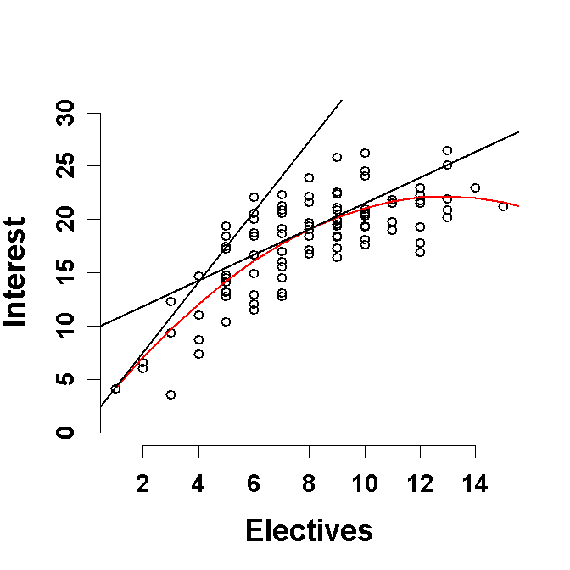
Simple Effects (Slopes)
Interest = 1.0 + 3.27*Electives + -0.13*Electives²
ΔInterest/ ΔElectives = 3.27 – 0.26 * Electives
For Electives = 0: ΔInterest/ ΔElectives = 3.27 – 0.26 * (0) = 3.3
For Electives = 8.17 : ΔInterest/ ΔElectives = 3.27 – 0.26 * (8.17) = 1.2

Slide 37
Conditional effect of Xi
The partial derivative of a sum, with respect to X_{i}, equals the sum of the partial derivatives of the components of that sum.
The partial derivative of aX_{i}^{M}, with respect to X_{i} is aMX_{i}^{M-1}, where a can be either a constant or another variable (or some combination of both
The partial derivative of a component of a sum, with respect to X_{i}, where that component does not contain X_{i}, is zero
Y = 2 + 3X₁
What is the formula that describes the magnitude of the X₁ effect on Y (ΔY/ ΔX₁) and why does this make sense?
ΔY/ ΔX₁ = 3 This makes sense because this is a simple linear model and the effect of X₁ is the same across the whole range of X₁ values.

Slide 38
Conditional effect of Xi
The partial derivative of a sum, with respect to X_{i}, equals the sum of the partial derivatives of the components of that sum.
The partial derivative of aX_{i}^{M}, with respect to X_{i} is aMX_{i}^{M-1}, where a can be either a constant or another variable (or some combination of both
The partial derivative of a component of a sum, with respect to X_{i}, where that component does not contain X_{i}, is zero
Y = 7 + 5X₁ + 4X₂
What is the formula that describes the magnitude of the X₁ effect on Y (ΔY/ ΔX₁) across the range of X₁ scores and why does this make sense?
ΔY/ ΔX₁ = 5 This makes sense because this is an additive model and the effect of X₁ is the same across the whole range of X₁ and X₂ values. Similarly, ΔY/ ΔX₂ = 4

Slide 39
Simple Effects (Slopes): Interactions!!!!
The partial derivative of a sum, with respect to X_{i}, equals the sum of the partial derivatives of the components of that sum.
The partial derivative of aX_{i}^{M}, with respect to X_{i} is aMX_{i}^{M-1}, where a can be either a constant or another variable (or some combination of both
The partial derivative of a component of a sum, with respect to X_{i}, where that component does not contain X_{i}, is zero
BC Intent= -1 + 6*Attitudes + 1*Peer Pressure + -1*ATTxPP
What is the formula the describes the magnitude of the Attitudes effect on BC Intent (ΔBC Intent/ ΔAttitude)
ΔBC Intent/ΔAttitudes = 6 - 1*Peer Pressure

Slide 40
Simple Effects (Slopes): Interactions!!!!
The partial derivative of a sum, with respect to X_{i}, equals the sum of the partial derivatives of the components of that sum.
The partial derivative of aX_{i}^{M}, with respect to X_{i} is aMX_{i}^{M-1}, where a can be either a constant or another variable (or some combination of both
The partial derivative of a component of a sum, with respect to X_{i}, where that component does not contain X_{i}, is zero
BC Intent= -1 + 6*Attitudes + 1*Peer Pressure + -1*ATTxPP
What is the formula the describes the magnitude of the Peer pressure effect on BC Intent (ΔBC Intent/ ΔPeer pressure)
ΔBC Intent/ΔPeer Pressure = 1 - 1*Attitudes

Slide 41
Sample Results Section
We regressed Interest on regressors that modeled the linear and quadratic effects of Number of Electives. Number of Electives was mean-centered in the primary analyses. We report raw regression coefficients (Bs) and partial eta² (η_{p}²), as appropriate, to quantify effect sizes.
[This is paragraph optional in some cases]
The overall effect of Number of Electives was significant, F(2,97) = 99.62, p< .0001, with Number of Electives accounting for 67.3% of the total variance in Interest.
The linear effect of Electives was significant, B= 1.2, η_{p}²= .651, t(97)= 13,45, p < .0001, indicating that taking an additional elective was associated with at 1.2 point increase in interest for participants who had already taken an average number of electives. However, the quadratic effect of Electives was also significant, B=-0.1, t(97)= 5.75, p < .0001, indicating that the magnitude of the Electives effect decreased by .02 for every additional Elective taken.
[This is paragraph optional in some cases]
Formal testing of simple effects of Electives across meaningful values for Electives indicated that the magnitude of the Electives effects was significant for participants who had taken no previous electives, B= 3.3, η_{p}²= .434, t(97)= 8.62, p< .0001. The effect of Electives was also significant for participants who had taken a low number of electives (i.e., mean - 1 SD; 5.1 electives), B= 2.0, η_{p}²= .582, t(97)= 11.63, p< .0001 and a high number of electives (i.e., mean + 1 SD; 11.3 electives), B= 0.4, η_{p}²= .072, t(97)= 2.73, p= .0074.

Slide 42
Multiple Regression with Non-Linear Effects
The non-linear effects of individual variables can be evaluated in models that contain other variables as well.
For example, lets examine the effect of Age and Weekly training miles on cross country skiers 5K race time. We might expect that there are diminishing returns with increasing weekly mileage and at some point more miles may even hurt.
Describe the expected relationship between Miles and 5K times?
Why would we include Age as an additional predictor in this model (4 reasons)?
We would expected a non-linear relationship between Miles and 5K. The relationship should generally be negative with an increase in miles leading to a decrease in 5K times. However, the magnitude of the decrease in 5K Time per Mile increase will not be constant. The magnitude of this effect will decrease across the distribution of Miles.
1. To simultaneously study Age effects in the same sample. 2. To use Age as a covariate to increase power to test Miles effect. 3. To use Age as a covariate to examine “unique” effect of Miles controlling for Age. 4. To test for an interaction between Age and Miles

Slide 43
Multiple Regression with Non-Linear Effects
Describe how to test the non-linear (polynomial) additive effects of Miles on 5K Times, controlling for Age?
Estimate two models: compact and augmented
Compact model includes only cAge (centered?)
Augmented model adds cMiles and cMiles² (centered?)
Test of coefficient for cMiles² indicates if the effect of training miles on races times changes based on number of miles skied.
Coefficient for cMiles indicates effect of miles for someone who skies an average number of miles.
Model comparison of augmented to compact model provides test of overall Miles effect. NOTE: There is no single coefficient to test. Must use model comparison approach.
Test of coefficient for cAge in augmented model provides test of Age effect (controlling for miles).
Can re-center Miles on other values to determine linear effect across range of scores. Can quantify effect via model formula using partial derivative

Slide 44
Multiple Regression with Non-Linear Effects
mC = lm(Time ~ cAge, data=dMiles)
summary(mC)
Coefficients
Estimate SE t-statistic Pr(>|t|)
(Intercept) 23.55225 0.52421 44.929 < 2e-16 ***
cAge 0.21677 0.04562 4.752 0.00000903 ***
---
Sum of squared errors (SSE): 1714.7, Error df: 78
R-squared: 0.2245
mA = lm(Time ~ cAge + cMiles + I(cMiles^2),data=dMiles)
summary(mA)
Coefficients
Estimate SE t-statistic Pr(>|t|)
(Intercept) 22.037345 0.481184 45.798 < 2e-16 ***
cAge 0.168096 0.027779 6.051 0.0000000505 ***
cMiles -0.256454 0.023236 -11.037 < 2e-16 ***
I(cMiles^2) 0.008027 0.001927 4.165 0.0000814131 ***
---
Sum of squared errors (SSE): 603.4, Error df: 76
R-squared: 0.7271

Slide 45
Multiple Regression with Non-Linear Effects
modelCompare(mC,mA)
SSE (Compact) = 1714.72
SSE (Augmented) = 603.4482
PRE = 0.6480778
F(2,76) = 69.9784, p = 5.820688e-18

Slide 46
Multiple Regression with Non-Linear Effects
Describe and test the effect of Age on 5K Times, controlling for Miles?
This is obtained from the augmented model. Age has a significant positive effect on 5K race times, controlling for Weekly miles, b= 0.17, ΔR²= 0.13, t(76)= 6.05, p< .001. For every one year increase in Age, 5K race times increase by .17 minutes.
modelSummary(mA)
Coefficients:
Estimate Std. Error t value Pr(>|t|)
(Intercept) 22.037345 0.481184 45.798 < 2e-16
cAge 0.168096 0.027779 6.051 5.05e-08
cMiles -0.256454 0.023236 -11.037 < 2e-16
I(cMiles^2) 0.008027 0.001927 4.165 8.14e-05
modelEffectSizes(mA)
Coefficients
SSR df pEta-sqr dR-sqr
(Intercept) 16654.1790 1 0.9650 NA
cAge 290.7416 1 0.3251 0.1315
cMiles 967.2142 1 0.6158 0.4374
I(cMiles^2) 137.7470 1 0.1858 0.0623
Sum of squared errors (SSE): 603.4
Sum of squared total (SST): 2211.1

Slide 47
Multiple Regression with Non-Linear Effects
Is there evidence that the effect of Miles is quadratic?
This is tested in the augmented model via the coefficient for Miles². This coefficient is significant, which indicates that it adds unique variance beyond the linear component. This also means that the size of the linear miles effects changes based on miles (conceptual link to interaction?).
Coefficients
Estimate SE t-statistic Pr(>|t|)
(Intercept) 22.037345 0.481184 45.798 < 2e-16 ***
cAge 0.168096 0.027779 6.051 0.0000000505 ***
cMiles -0.256454 0.023236 -11.037 < 2e-16 ***
I(cMiles^2) 0.008027 0.001927 4.165 0.0000814131 ***
---
Sum of squared errors (SSE): 603.4, Error df: 76
R-squared: 0.7271

Slide 48
Multiple Regression with Non-Linear Effects
Describe and test the overall effect of Miles, controlling for Age?
This is tested via model comparison for the augmented (age, miles, miles²) vs. compact (age only) models. There is a significant overall effect of miles on 5K times, F(2,76) = 69.98, p < .001, with weekly mileage accounting for 64.8% of the unexplained variance in 5K times after controlling for age.
modelCompare(mC,mA)
SSE (Compact) = 1714.72
SSE (Augmented) = 603.4482
PRE = 0.6480778
F(2,76) = 69.9784, p = 5.820688e-18

Slide 49
Multiple Regression with Non-Linear Effects
What do you want to report to describe the Miles effect?
Size of overall effect in variance terms and sig. test (last slide)
b (ΔR² or partial eta²?) and sig tests for linear and quadratic term in centered model
Magnitude (and tests) of simples slopes?
Overall form of relationship between Miles and 5K times?

Slide 50
Multiple Regression with Non-Linear Effects
Describe and test the “average” linear effect of miles.
There was a significant negative linear effect of Miles for skiers with average weekly mileage, b= -0.26, , ΔR²= 0.44, t(76)= 11.04, p< .001. A one mile increase for runners with average weekly mileage is associated with a .26 minute decrease in 5K times.
Coefficients
Estimate SE t-statistic Pr(>|t|)
(Intercept) 22.037345 0.481184 45.798 < 2e-16 ***
cAge 0.168096 0.027779 6.051 0.0000000505 ***
cMiles -0.256454 0.023236 -11.037 < 2e-16 ***
I(cMiles^2) 0.008027 0.001927 4.165 0.0000814131 ***
---
Signif. codes: 0 ‘***’ 0.001 ‘**’ 0.01 ‘*’ 0.05 ‘.’ 0.1 ‘ ’ 1
Sum of squared errors (SSE): 603.4, Error df: 76
R-squared: 0.72716

Slide 51
Multiple Regression with Non-Linear Effects
Report B and sig test for quadratic effect.
However, there was also a significant quadratic effect for Miles, b= 0.01, ΔR²= 0.06, t(76)= 4.17, p< .001. This indicates that for every one mile increase in weekly mileage, the magnitude of the linear mileage effects decreases.
Coefficients
Estimate SE t-statistic Pr(>|t|)
(Intercept) 22.037345 0.481184 45.798 < 2e-16 ***
cAge 0.168096 0.027779 6.051 0.0000000505 ***
cMiles -0.256454 0.023236 -11.037 < 2e-16 ***
I(cMiles^2) 0.008027 0.001927 4.165 0.0000814131 ***
---
Signif. codes: 0 ‘***’ 0.001 ‘**’ 0.01 ‘*’ 0.05 ‘.’ 0.1 ‘ ’ 1
Sum of squared errors (SSE): 603.4, Error df: 76
R-squared: 0.7271

Slide 52
Simple Effects (Slopes)
dMiles$hMiles = dMiles$cMiles - sd(dMiles$cMiles)
mHigh= lm(Time ~ cAge + hMiles + I(hMiles^2),data=dMiles)
Coefficients
Estimate SE t-statistic Pr(>|t|)
(Intercept) 20.026014 0.449986 44.504 < 2e-16 ***
cAge 0.168096 0.027779 6.051 0.0000000505 ***
hMiles -0.034521 0.058311 -0.592 0.556
I(hMiles^2) 0.008027 0.001927 4.165 0.0000814131 ***
---
Sum of squared errors (SSE): 603.4, Error df: 76
R-squared: 0.7271
dMiles$lMiles = dMiles$cMiles + sd(dMiles$cMiles)
mLow= lm(Time ~ cAge + lMiles + I(lMiles^2),data=dMiles)
Coefficients
Estimate SE t-statistic Pr(>|t|)
(Intercept) 27.116838 0.449930 60.269 < 2e-16 ***
cAge 0.168096 0.027779 6.051 0.00000005048546 ***
lMiles -0.478387 0.057948 -8.256 0.00000000000357 ***
I(lMiles^2) 0.008027 0.001927 4.165 0.00008141310687 ***
---
Sum of squared errors (SSE): 603.4, Error df: 76
R-squared: 0.7271

Slide 53
Simple Effects (Slopes)
Report and test simple slopes
As described earlier, for runners with average weekly mileage, a one mile increase is associated with a .26 minute decrease in 5K times (p<.001).
For runners with low weekly mileage (i.e., 1 SD below mean), a mile increase is associated with a .48 minute decrease in 5K times (p< .001).
For runners with high weekly mileage (i.e., 1 SD above mean), a mile increase is associated with a non-significant .03 minute decrease in 5K times (p= .556).

Slide 54
Simple Effects (Slopes)
mrA= lm(Time ~ cAge + Miles + I(Miles^2),data=dMiles)
summary(mrA)
Coefficients:
Estimate Std. Error t value Pr(>|t|)
(Intercept) 36.862826 1.550650 23.773 < 2e-16
cAge 0.168096 0.027779 6.051 5.05e-08
Miles -0.736047 0.117271 -6.276 1.96e-08
I(Miles^2) 0.008027 0.001927 4.165 8.14e-05
Describe the mileage effect as a formula (Δ5K Time/ ΔMiles)
5K Times= 36.9 + 0.17 * cAge + -0.74 * Miles+ 0.01 * Miles²
Δ5K Time/ ΔMiles= -.74 + 0.02 * Miles

Slide 55
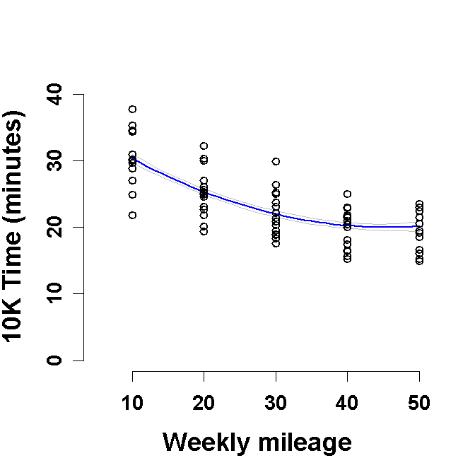
Displaying the Mileage Effect
Scatterplot with prediction line and error bands for mean Age
Could graph multiple lines for different ages (what would it look like?)
Could remove Age variance from scatterplot points (how?)

Slide 56
Multiple Regression with Non-Linear Effects
What would have changed had we 1) not centered Age or 2) not centered Miles?
Not centering AGE has no effect on AGE or MILES coefficients. There are no higher order (interactive or non-linear) effects involving AGE
Not centering Miles will change Miles coefficient b/c Miles is in a higher order effect involving Miles (i.e., nonlinear Miles²). Miles will be simple effect at 0 on Miles if not centered.
Not centering Miles has not effect on AGE b/c AGE is not in a higher order (interactive) effect with Miles.
Scale of both Age and Miles DOES affect intercept (b₀).

